Slide 1
California Lutheran University Creative Technology Project 4 - A/V editing tool
Kevin T. Duraj
Weijian Ji
Shu-Wei Lin
Yuanye Zeng

Slide 2
iTunes Tool for Ripping and Converting medial formats
iTunes is a media player, media library, and mobile device management application developed by Apple Inc.
It is used to play, download, and organize digital audio and video on personal computers
It is also used to Rip and Convert audio media
Notes:
iTunes is a media player, media library, and mobile device management application developed by Apple Inc. It is used to play, download, and organize digital audio and video on personal computers running the OS X and Microsoft Windows operating systems. The iTunes Store is also available on the iPod Touch, iPhone, and iPad.
Through the iTunes Store, users can purchase and download music, music videos, television shows, audiobooks, podcasts, movies, and movie rentals in some countries, and ringtones, available on the iPhone and iPod Touch (fourth generation onward). Application software for the iPhone, iPad and iPod Touch can be downloaded from the App Store.
Ripping a CD means to copy songs from the CD to a computer hard disk. iTunesis an application from Apple that enables you to copy music from any CD onto your computer for free. You can then easily manage downloaded music files using Windows Media Player.

Slide 3
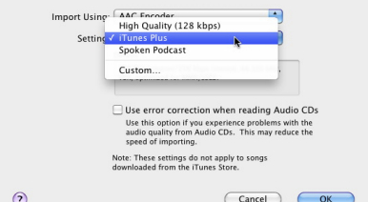
RIP CD to iTune MP3
Notes:
iTunes is a media player, media library, and mobile device management application developed by Apple Inc. It is used to play, download, and organize digital audio and video on personal computers running the OS X and Microsoft Windows operating systems. The iTunes Store is also available on the iPod Touch, iPhone, and iPad.
Through the iTunes Store, users can purchase and download music, music videos, television shows, audiobooks, podcasts, movies, and movie rentals in some countries, and ringtones, available on the iPhone and iPod Touch (fourth generation onward). Application software for the iPhone, iPad and iPod Touch can be downloaded from the App Store.
Ripping a CD means to copy songs from the CD to a computer hard disk. iTunesis an application from Apple that enables you to copy music from any CD onto your computer for free. You can then easily manage downloaded music files using Windows Media Player.

Slide 4
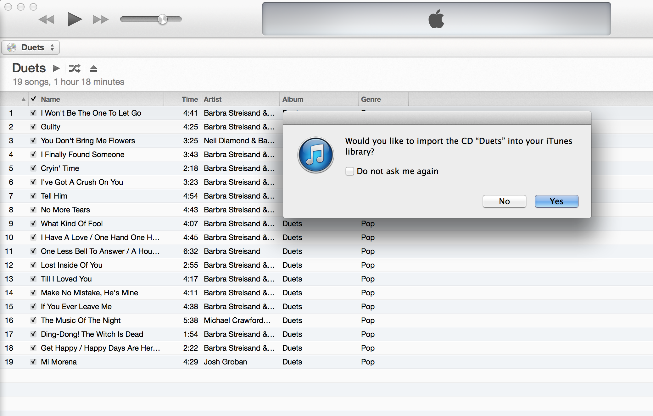
.
Notes:
iTunes is a media player, media library, and mobile device management application developed by Apple Inc. It is used to play, download, and organize digital audio and video on personal computers running the OS X and Microsoft Windows operating systems. The iTunes Store is also available on the iPod Touch, iPhone, and iPad.
Through the iTunes Store, users can purchase and download music, music videos, television shows, audiobooks, podcasts, movies, and movie rentals in some countries, and ringtones, available on the iPhone and iPod Touch (fourth generation onward). Application software for the iPhone, iPad and iPod Touch can be downloaded from the App Store.
Ripping a CD means to copy songs from the CD to a computer hard disk. iTunesis an application from Apple that enables you to copy music from any CD onto your computer for free. You can then easily manage downloaded music files using Windows Media Player.
Apple iTunes and Amazon would love to sell you many of their music songs despite you might already purchased these songs on your old CD. There is a very good chance that you already have a many music CDs at home and now you might be thinking, how could I get it into my computer and then to my iPhone.

Slide 5
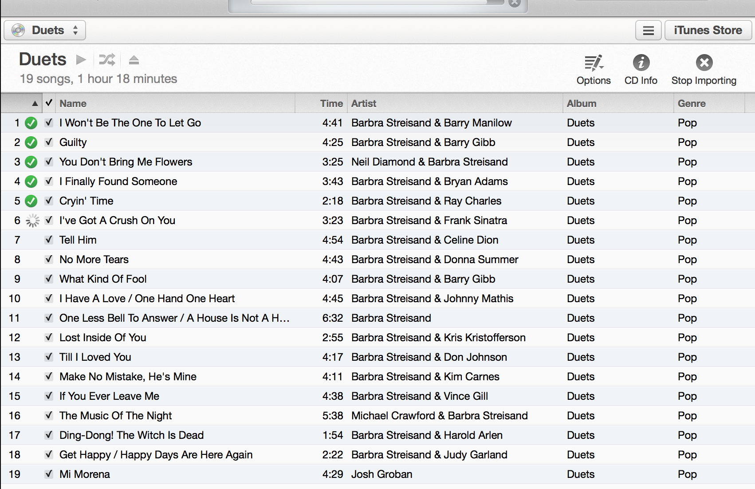
Ripping CD into MP3
Notes:
iTunes is a media player, media library, and mobile device management application developed by Apple Inc. It is used to play, download, and organize digital audio and video on personal computers running the OS X and Microsoft Windows operating systems. The iTunes Store is also available on the iPod Touch, iPhone, and iPad.
Through the iTunes Store, users can purchase and download music, music videos, television shows, audiobooks, podcasts, movies, and movie rentals in some countries, and ringtones, available on the iPhone and iPod Touch (fourth generation onward). Application software for the iPhone, iPad and iPod Touch can be downloaded from the App Store.
Ripping a CD means to copy songs from the CD to a computer hard disk. iTunesis an application from Apple that enables you to copy music from any CD onto your computer for free. You can then easily manage downloaded music files using Windows Media Player.
Apple iTunes and Amazon would love to sell you many of their music songs despite you might already purchased these songs on your old CD. There is a very good chance that you already have a many music CDs at home and now you might be thinking, how could I get it into my computer and then to my iPhone.

Slide 6
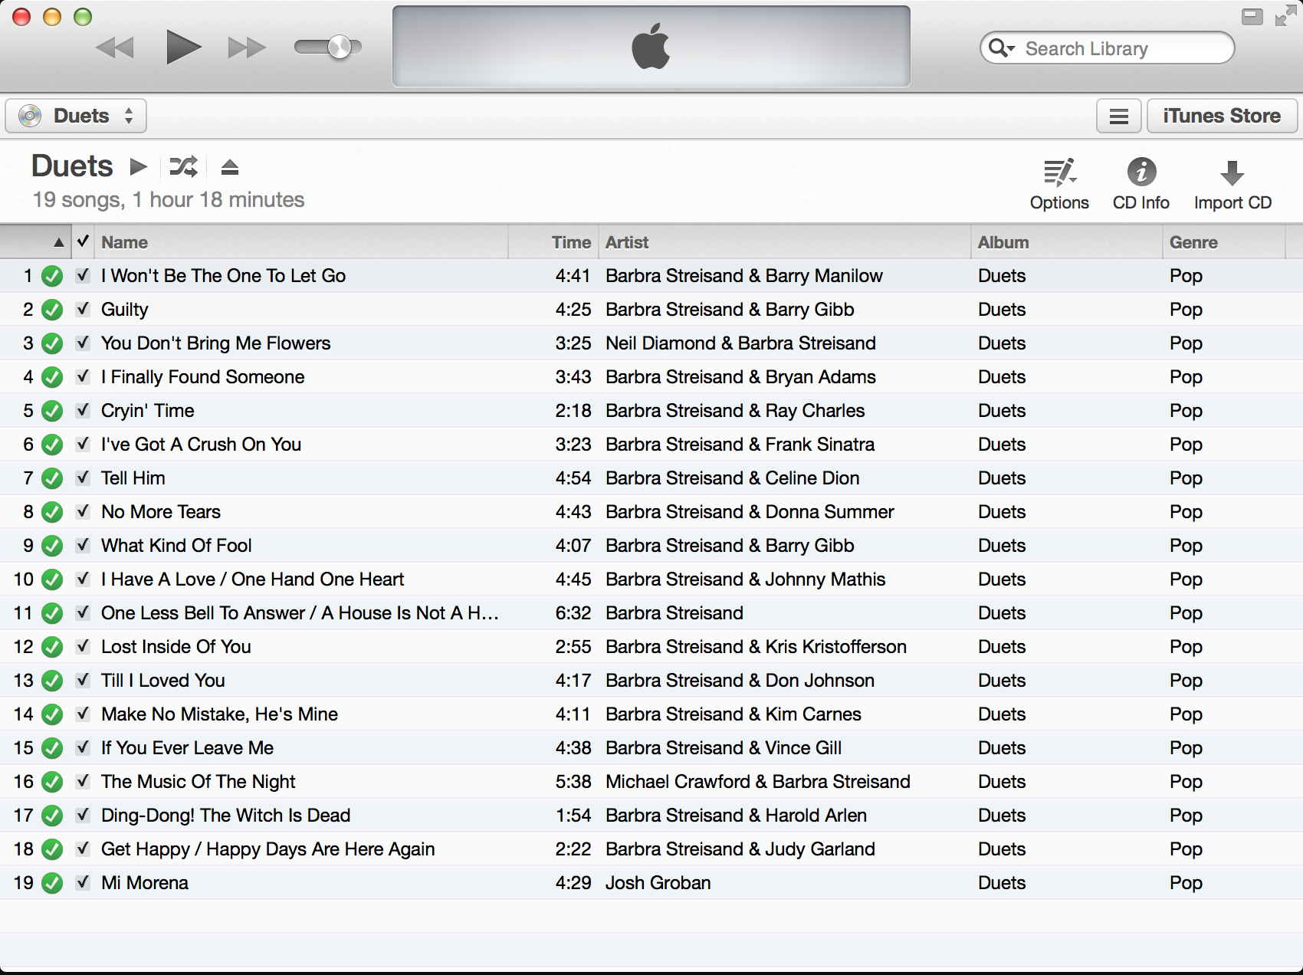
Ripping CD Completed
Notes:
iTunes is a media player, media library, and mobile device management application developed by Apple Inc. It is used to play, download, and organize digital audio and video on personal computers running the OS X and Microsoft Windows operating systems. The iTunes Store is also available on the iPod Touch, iPhone, and iPad.
Through the iTunes Store, users can purchase and download music, music videos, television shows, audiobooks, podcasts, movies, and movie rentals in some countries, and ringtones, available on the iPhone and iPod Touch (fourth generation onward). Application software for the iPhone, iPad and iPod Touch can be downloaded from the App Store.
Ripping a CD means to copy songs from the CD to a computer hard disk. iTunesis an application from Apple that enables you to copy music from any CD onto your computer for free. You can then easily manage downloaded music files using Windows Media Player.
Apple iTunes and Amazon would love to sell you many of their music songs despite you might already purchased these songs on your old CD. There is a very good chance that you already have a many music CDs at home and now you might be thinking, how could I get it into my computer and then to my iPhone.

Slide 7
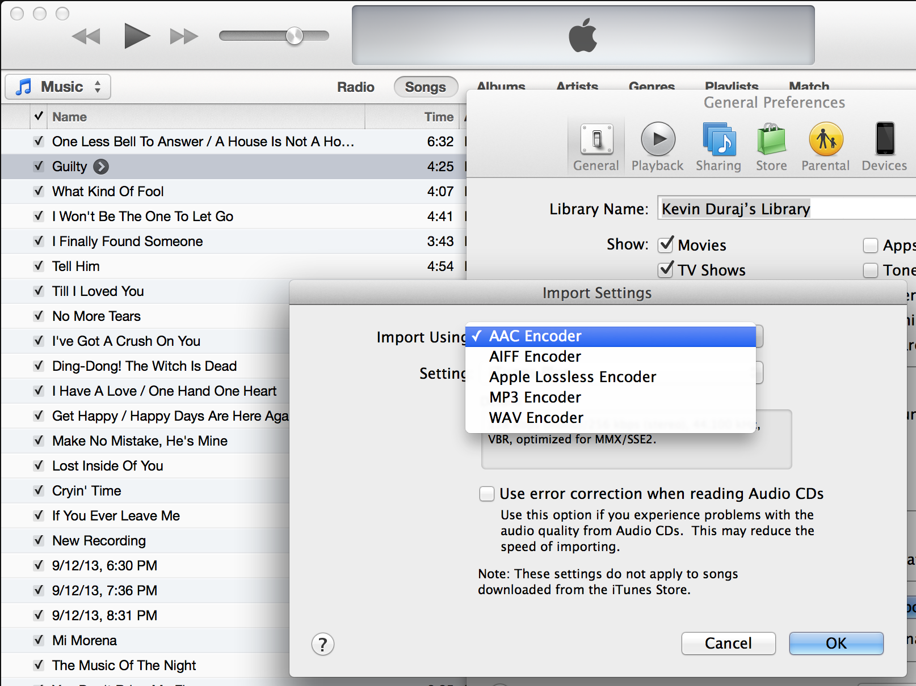
Default and New Audio Format
Notes:
iTunes is a media player, media library, and mobile device management application developed by Apple Inc. It is used to play, download, and organize digital audio and video on personal computers running the OS X and Microsoft Windows operating systems. The iTunes Store is also available on the iPod Touch, iPhone, and iPad.
Through the iTunes Store, users can purchase and download music, music videos, television shows, audiobooks, podcasts, movies, and movie rentals in some countries, and ringtones, available on the iPhone and iPod Touch (fourth generation onward). Application software for the iPhone, iPad and iPod Touch can be downloaded from the App Store.
Ripping a CD means to copy songs from the CD to a computer hard disk. iTunesis an application from Apple that enables you to copy music from any CD onto your computer for free. You can then easily manage downloaded music files using Windows Media Player.
Apple iTunes and Amazon would love to sell you many of their music songs despite you might already purchased these songs on your old CD. There is a very good chance that you already have a many music CDs at home and now you might be thinking, how could I get it into my computer and then to my iPhone.

Slide 8
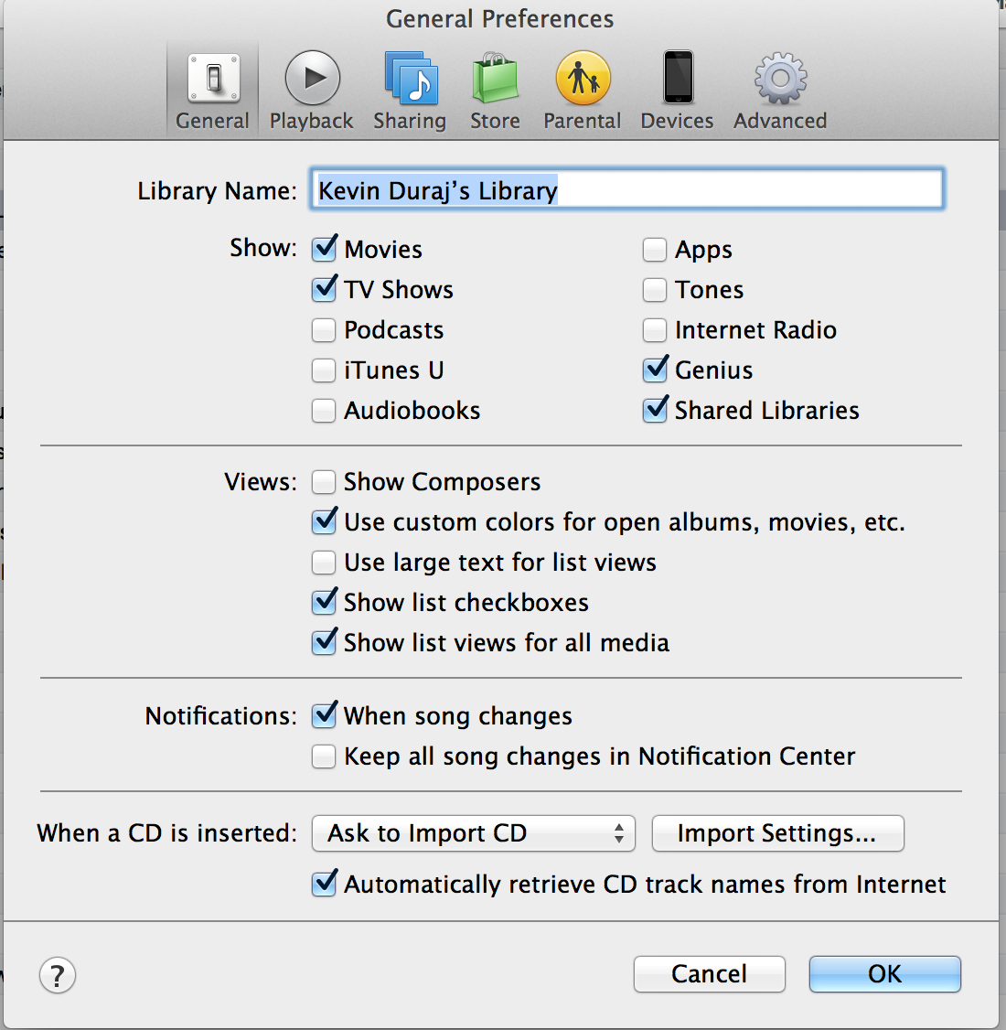
Convert Audio from ACC to MP3 - Import Setting

Slide 9
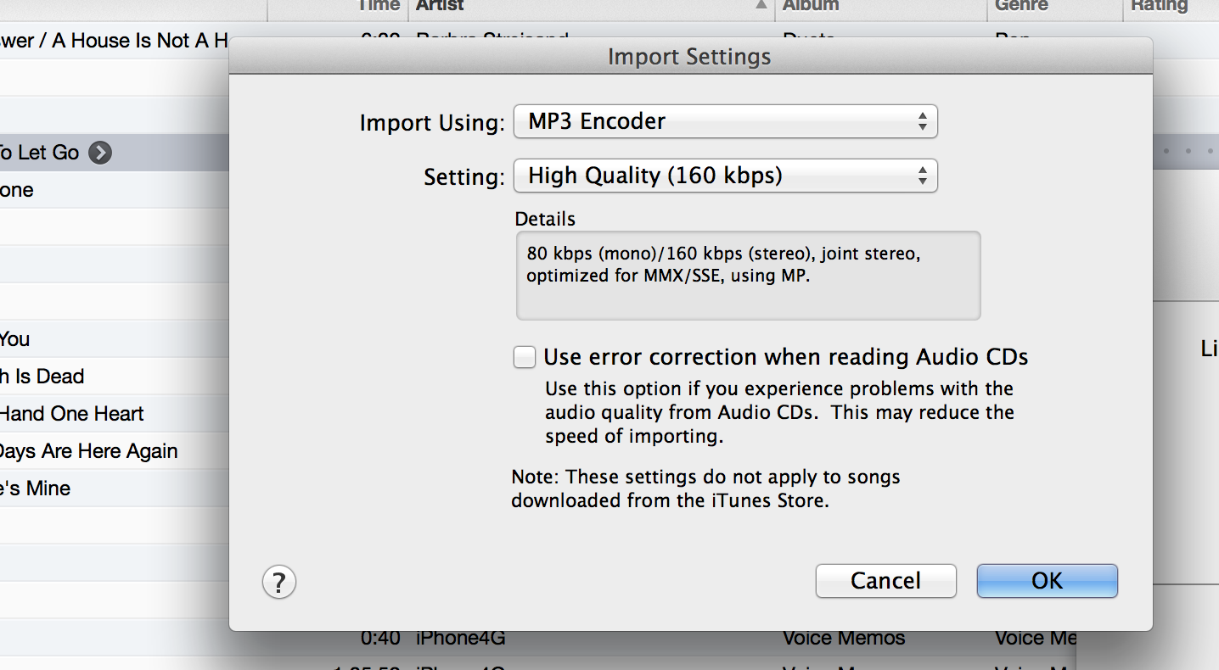
MP3 Encoder Selected

Slide 10
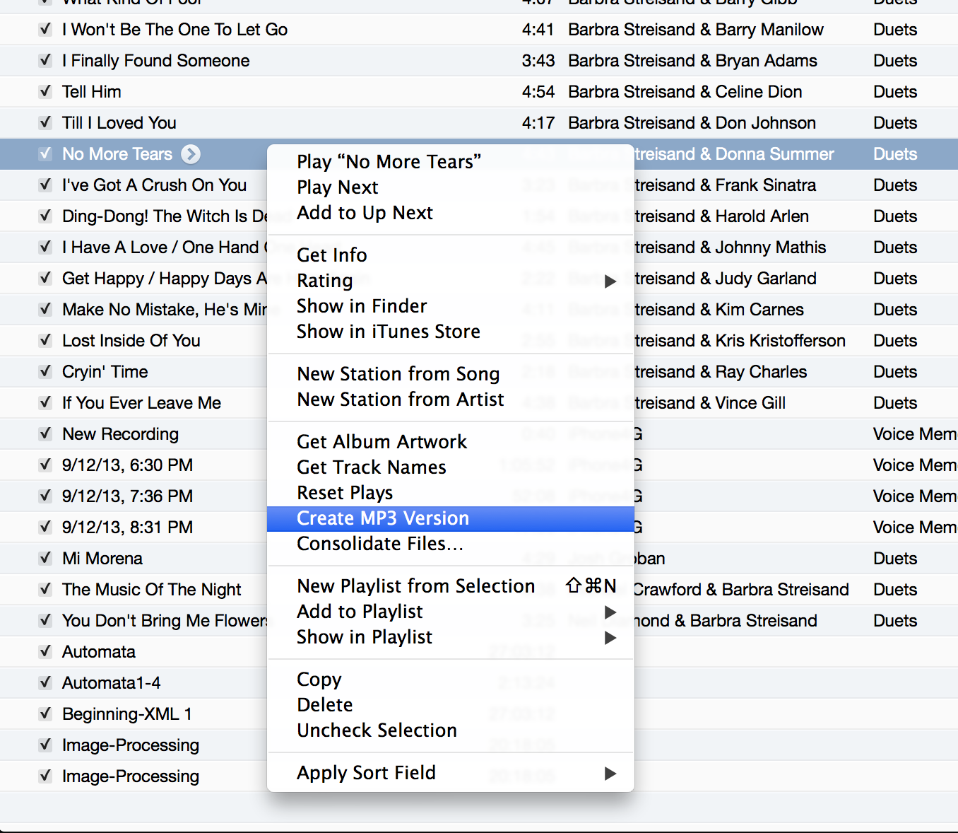
Create MP3 audio format from ACC format

Slide 11

Format Factory is a multimedia converter that can convert video, audio, and picture files. It is also capable of ripping DVDs and CDs to other file formats, as well as creating .iso images. It can also join multiple video files together into one.
It’s free.

Slide 12
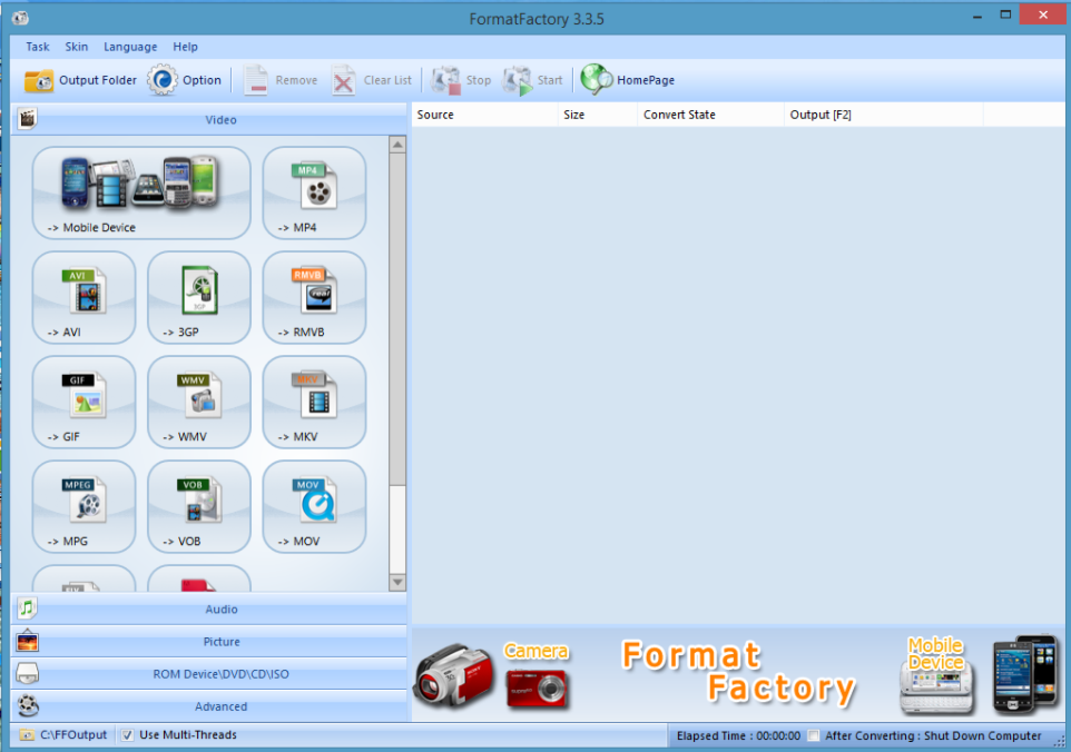
Convert

Slide 13
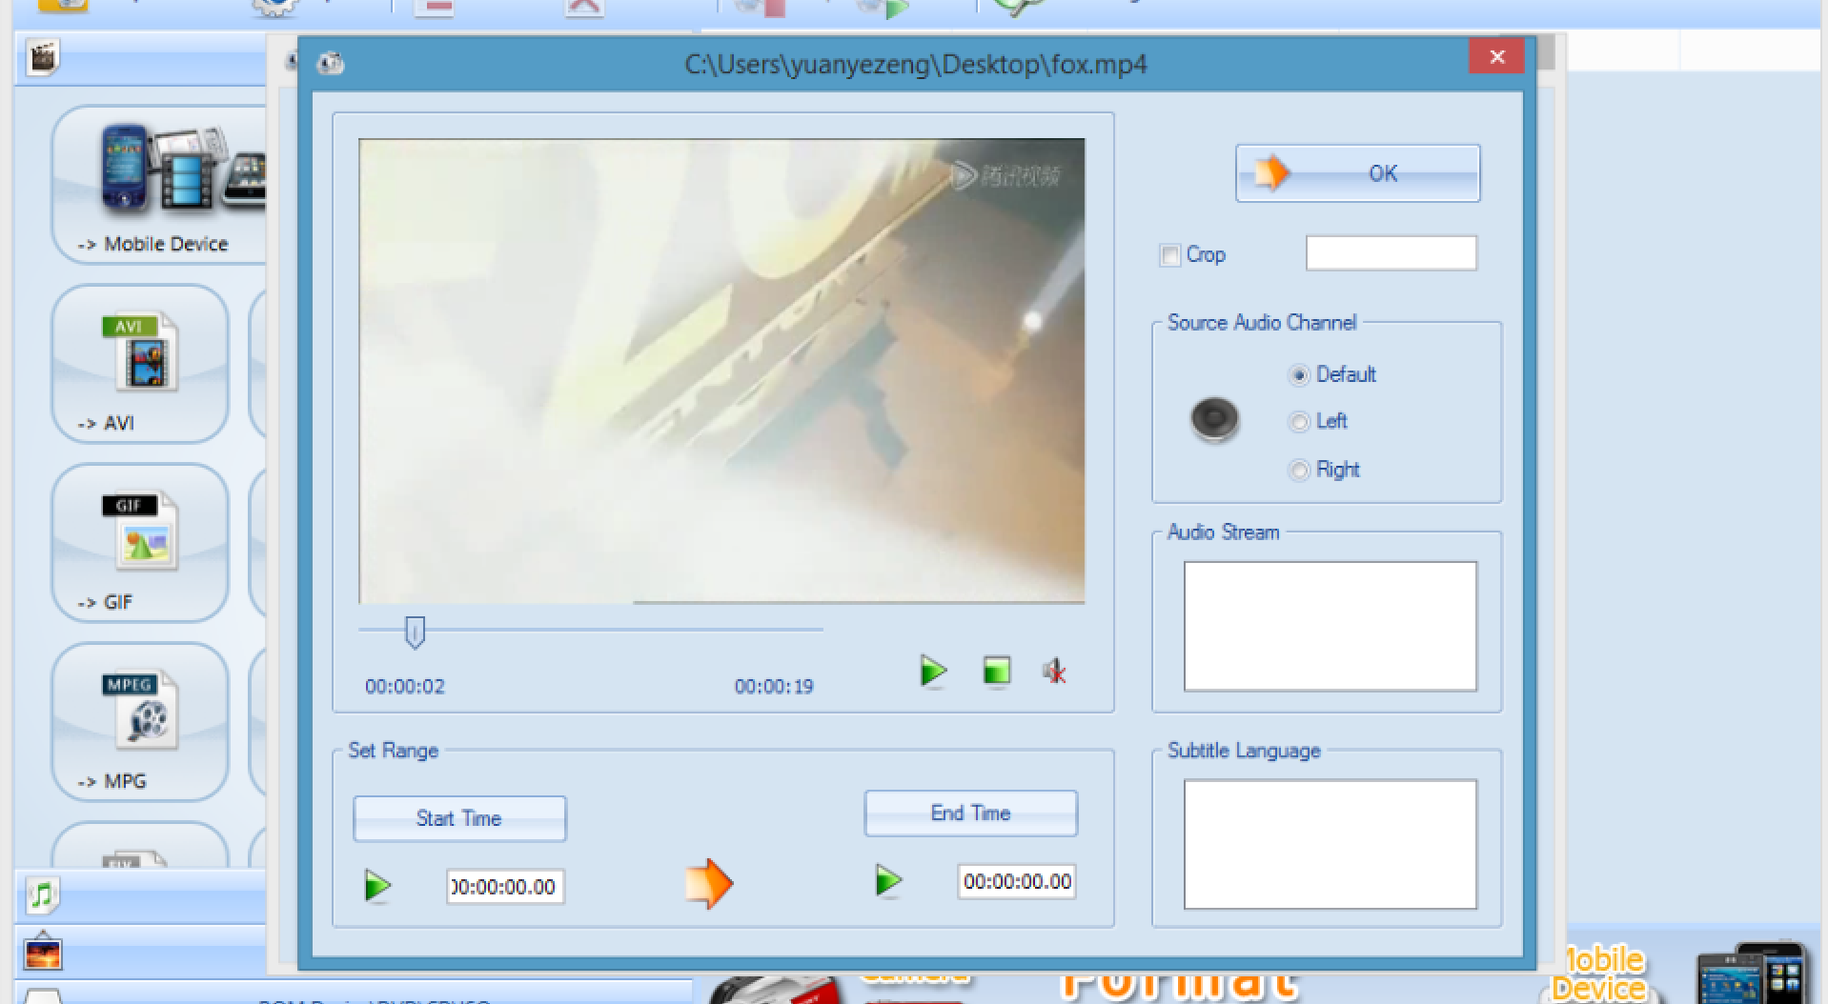
Ripping

Slide 14
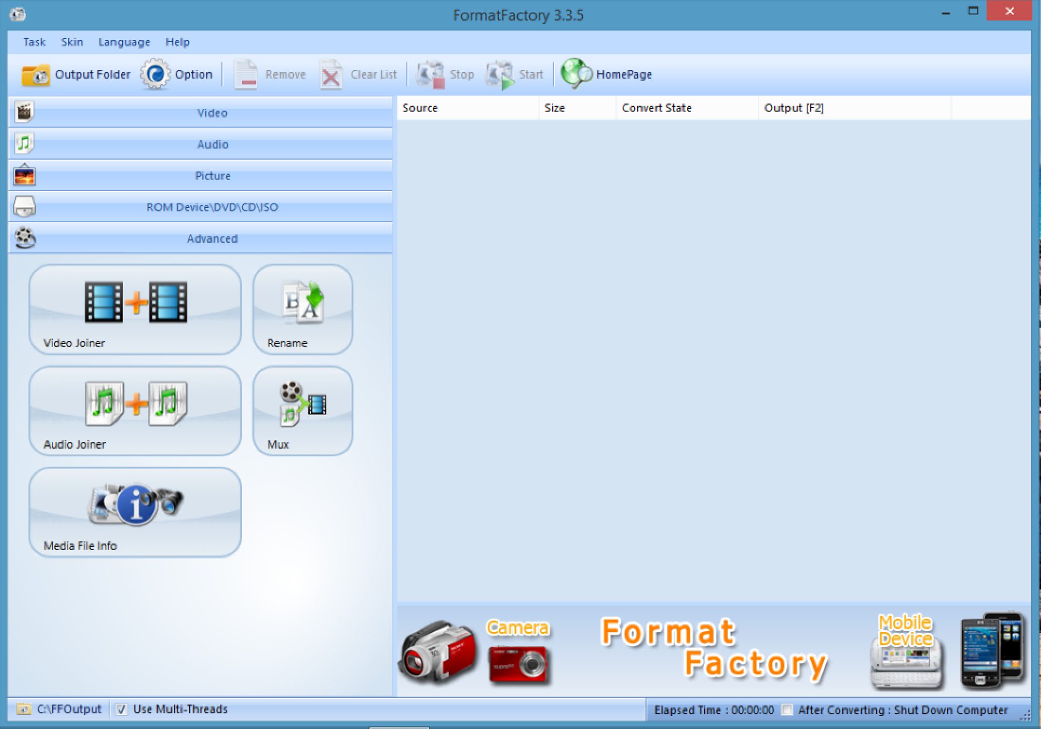
Edit

Slide 15
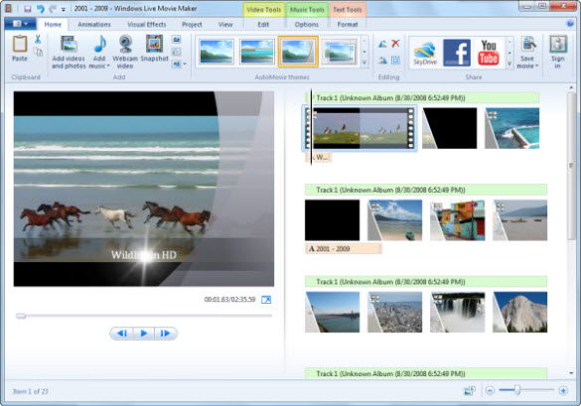
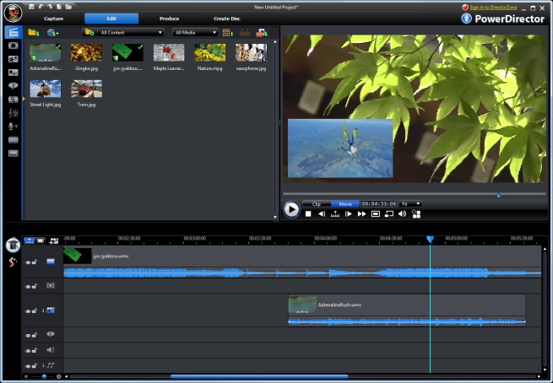
Edit video files
Recommanded tools:
Windows Movie Maker
Cyberlink Power Director

Slide 16
The Elements In a Movie Editor
1. Source area
2. Timeline
Arrange the sequence and the duration of sections of videos.
3. Text editor for subtitle
Text font, size, color, duration…
4. Effect
5. Transition
Fade in, fade out, slide in, slide out...

Slide 17
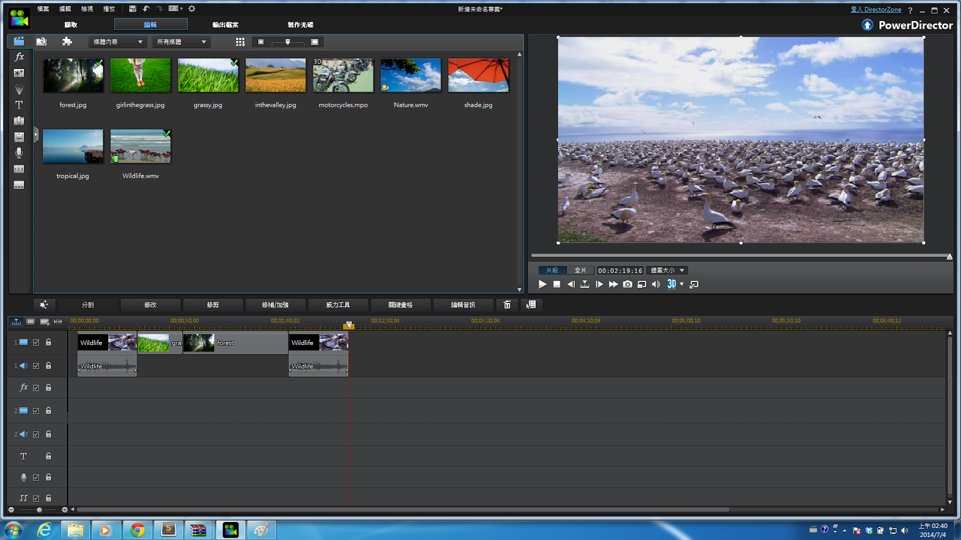
Instructions to Power Director

Slide 18
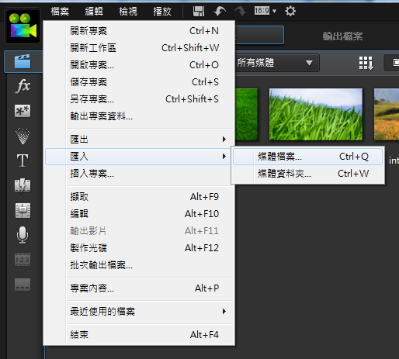
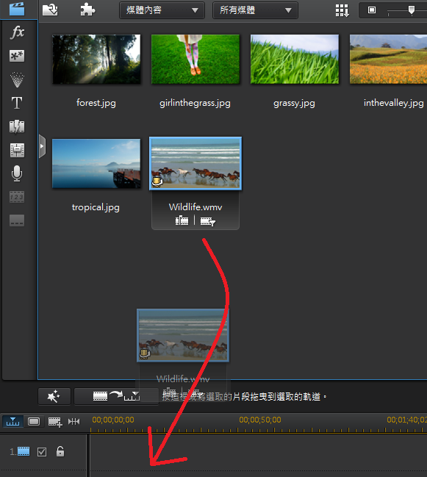
Instructions to Power Director

Slide 19
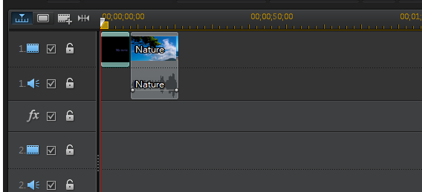
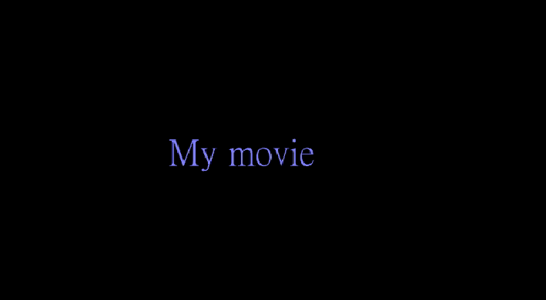
Instructions to Power Director
Adding new text paragraphs to the movie.

Slide 20
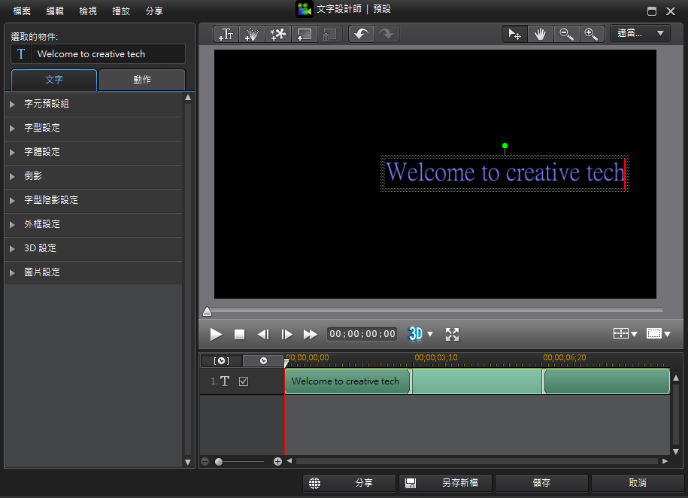
Instructions to Power Director
Editing text style, such as color, size, font, and so on...

Slide 21
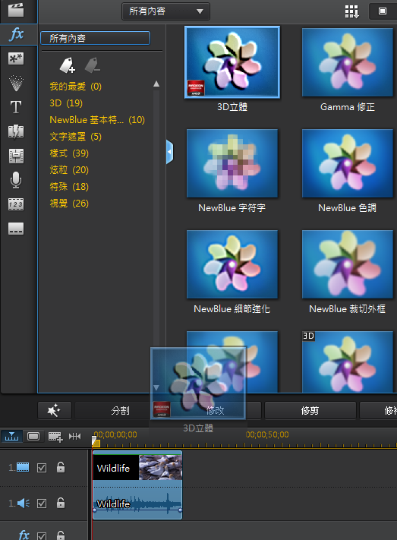

Instructions to Power Director

Slide 22
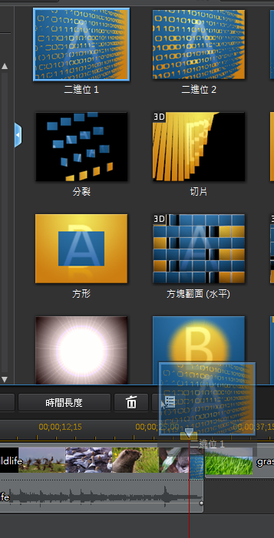

Instructions to Power Director

Slide 23
References
http://en.wikipedia.org/wiki/ITunes
http://www.pcfreetime.com/index.html

